Slide 1
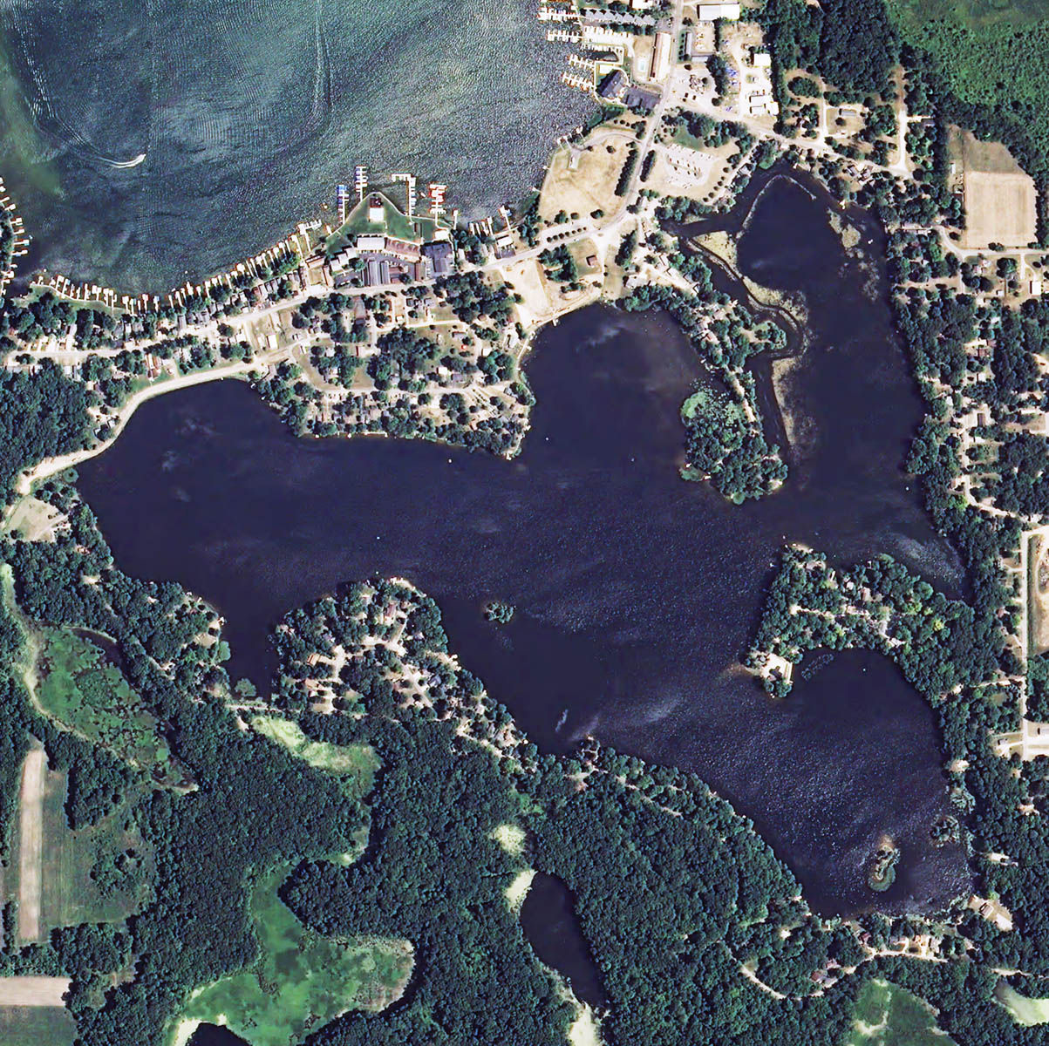
Lake Checkups: Water Quality Tests
A Multi-Media Communication Tool
Zac Martin, Randy Van Matre and
Anthony Serianni
Indiana Watershed Leadership Academy
Final Project
Conference Center – Fort Harrison State Park
May 21, 2014

Slide 2
Presentation Outline
Background: Who is the Audience? What are the Objectives?
How Will the Objectives Be Achieved?
What is the Message?
Summary

Slide 3
Presentation Outline
Background – Who is the Audience? What are the Objectives? (Anthony)
How Will the Objectives Be Achieved? (Randy)
What is the Message? (Randy and Zac)
Summary (Zac)

Slide 4
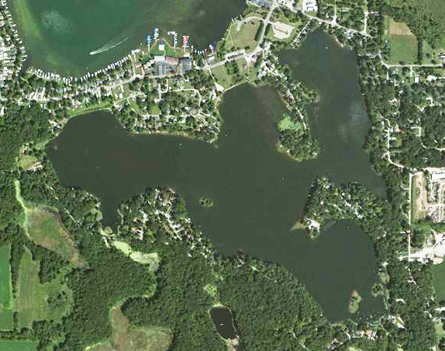
Aerial Photograph of Lake Papakeechie (LP)
179 acre private (non-sports) lake in Syracuse, Indiana
Part of the Wawasee Area Sub-watershed
N
LP is a beautiful relatively natural lake ecosystem on which
to develop, test and/or validate effective methods of lake stewardship
and preservation.

Slide 5
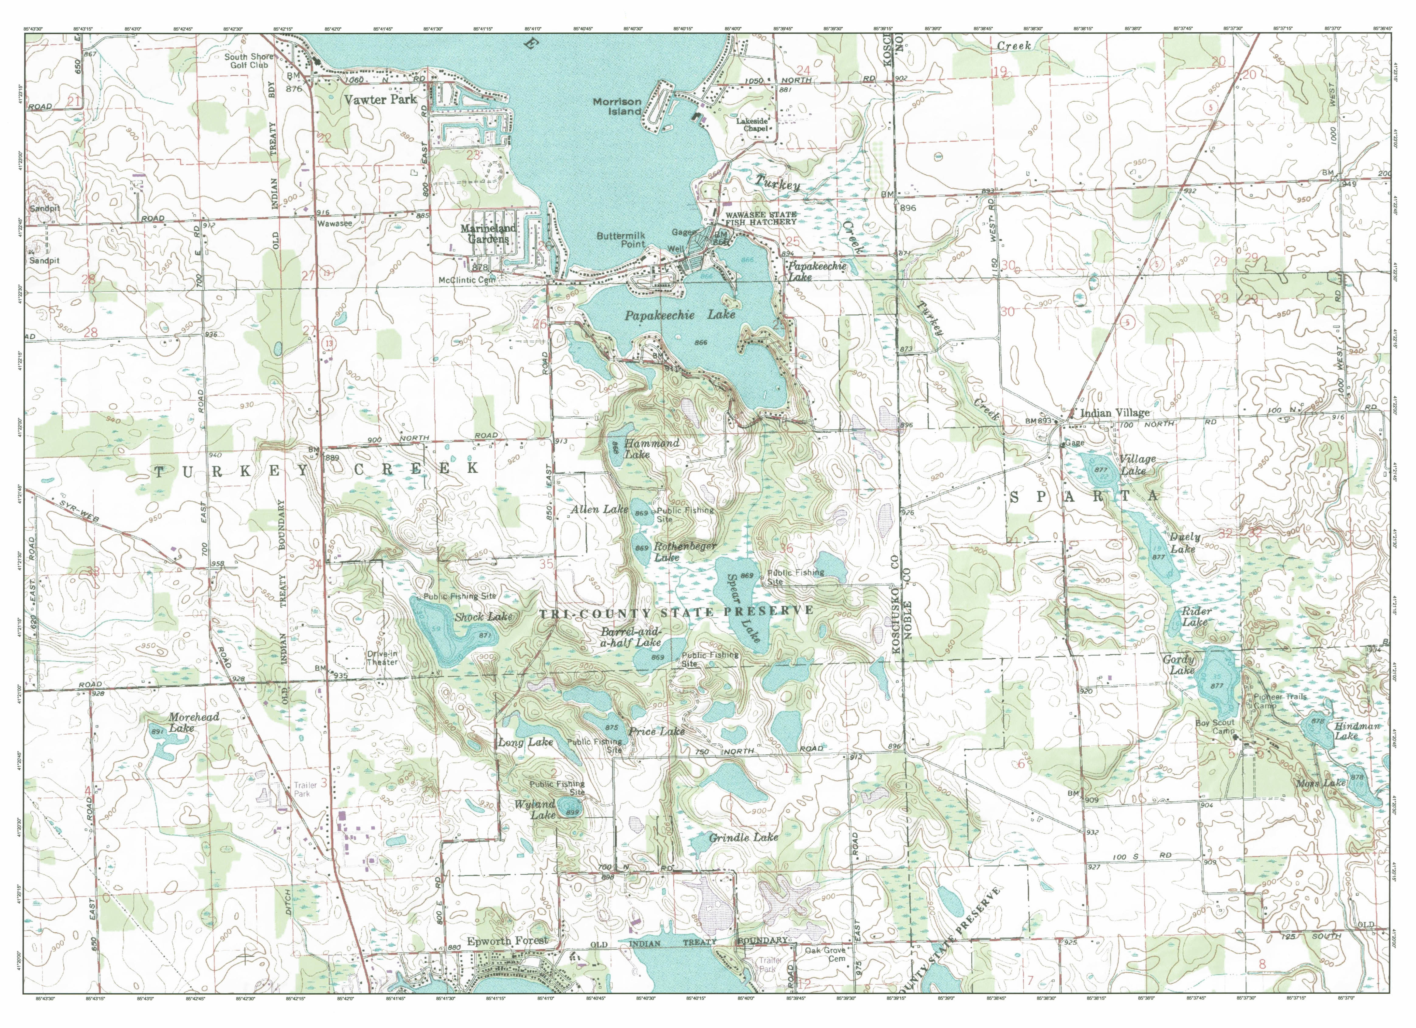
Partial Map of the Wawasee Subwatershed
Areas South of Lake Papakeechie (LP)
LP is part of a larger watershed; LP impacts, and is impacted by, this watershed.
Consequence: We need to pay attention not only to LP, but also to its environs.

Slide 6
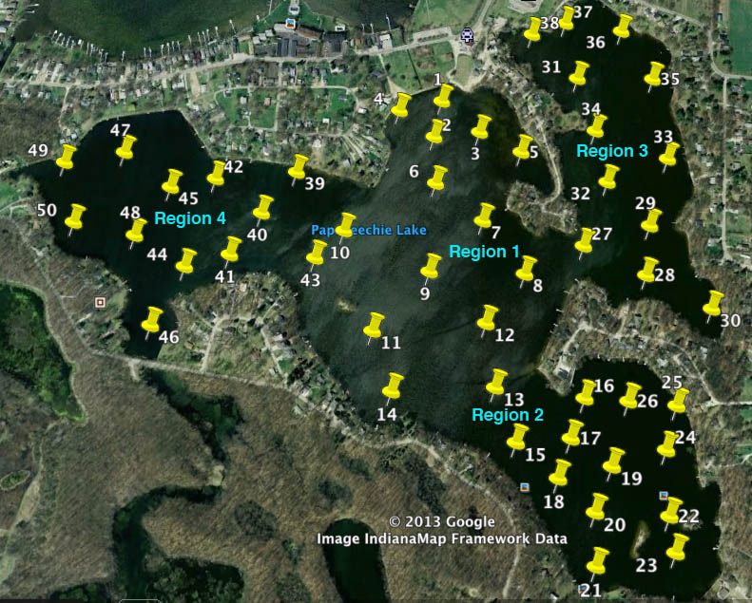
Partitioning of LP into Fifty (50) GPS-Defined Test Sites
Distributed in Four (4) Regions – Summer 2013

Slide 7
Current Water Testing on LP
Turbidity (Secchi disk)
Dissolved oxygen (DO)
Temperature
E. coli levels
Dissolved nitrogen (as nitrate)
Dissolved phosphorus (as inorganic PO₄⁻³)
Acidity (pH)
Chlorophyll a

Slide 8
Project Audience: Residents on Lake Papakeechie;
Leadership of the Papakeechie
Protective Association (PPA)
Project Objectives:
To educate and inform lake residents and leadership about modern chemical and biological methods to assess the quality of lake water;
To motivate lake residents to become personally involved in the work of LaPSI (Lake Papakeechie Sustainability Initiative);
To recruit and train citizen-scientists

Slide 9
Presentation Outline
Background: Who is the Audience? What are the Objectives? (Anthony)
How Will the Objectives Be Achieved? (Randy)
What is the Message? (Randy and Zac)
Summary (Zac)

Slide 10
Complementary Multi-Media Approach
Preparation of a Magnet: Contains very basic information about lake water testing, and encourages readers to consult the PPA web site for more information.
Preparation of a Tri-Fold Pamphlet: Contains more detailed information about lake water testing in a transportable medium, and encourages readers to consult the PPA web site for more information.
PPA Web Site. Key source of detailed information about lake water testing, other lake stewardship activities, and provides information on how lake residents can become more involved with lake management.

Slide 11
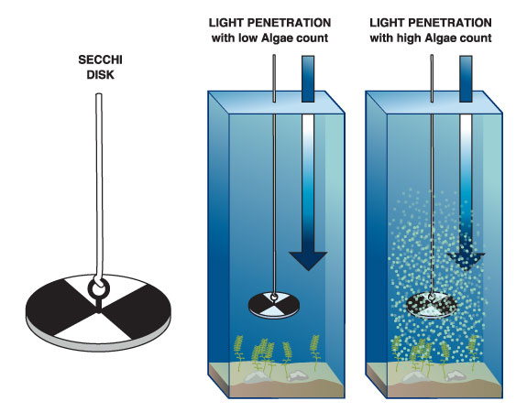
Turbidity - Secchi Disk
Used to measure water clarity/ turbidity.
8”-diameter disk, divided into black and white quadrants (limnology investigations).
Original is 12” and all white for ocean studies.

Slide 12
How to Use a Secchi Disk
Shady side of boat between 9 am and 3 pm. Best results are between 10 am and 2 pm.
Same observer and same manner every time.
Indiana Clean Lakes Program uses Secchi disks to monitor turbidity in over 80 Indiana lakes.

Slide 13
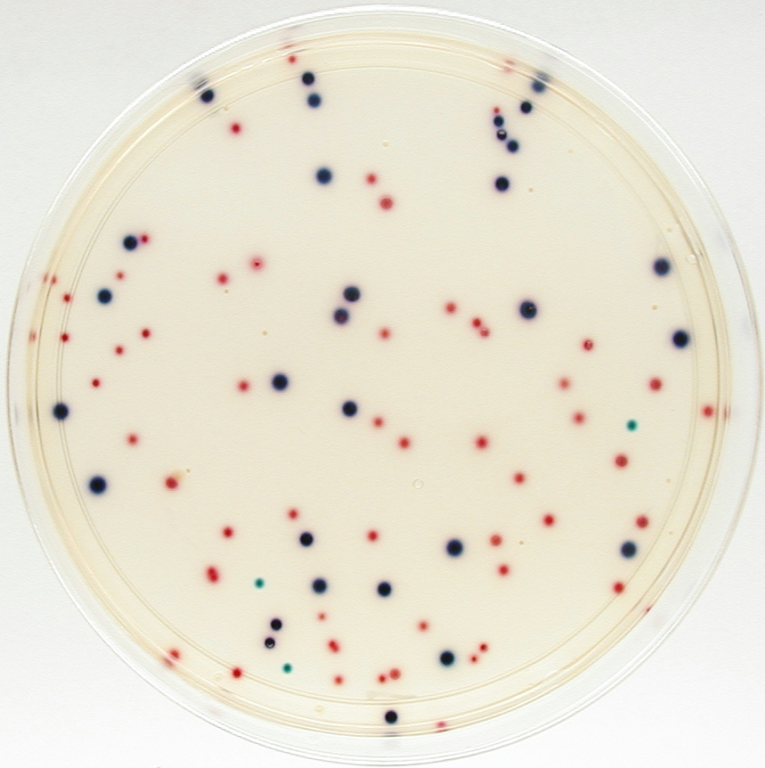
E. coli (Escherichia coliform)
Contact with humans can cause discomfort or illness.
Lakes containing high levels of bacteria are unsafe for activities that involve significant water contact.
A ColiscanTM plate

Slide 14
Sources of Contamination
E. coli contamination is commonly caused by pollution from poorly functioning septic systems.
Feces from waterfowl and other wildlife can also contribute significant amounts of E. coli to lakes.

Slide 15
What To Do
The state of Indiana sets standards to determine whether a lake is impaired by high levels of bacteria. Simple and convenient tests for measuring E. coli in lake water are available.
ISDH has a list of certified labs. Purdue Extension has several publications related to water quality, testing, etc.

Slide 16
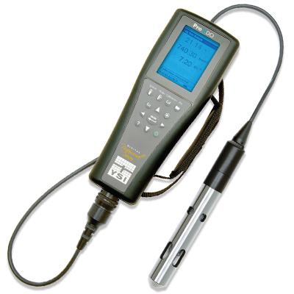
Dissolved Oxygen and Temperature
Many organisms require oxygen to live.
The availability of oxygen in lake water determines which organisms can exist and thrive.
Graphs of DO or T versus lake depth can be strong indicators of lake health.
DO and T are measured with a scientific meter.
DO values can be used to calculate TSI values.

Slide 17
Presentation Outline
Background: Who is the Audience? What are the Objectives? (Anthony)
How Will the Objectives Be Achieved? (Randy)
What is the Message? (Randy and Zac)
Summary (Zac)

Slide 18
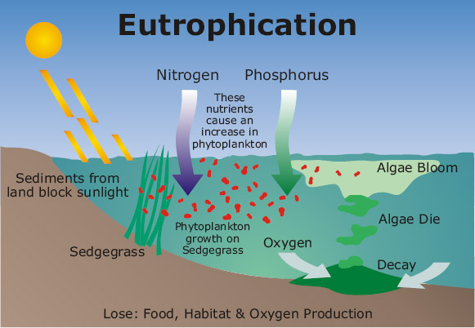
Nitrogen and Phosphorus
Nitrogen (N) and phosphorus (P) are required by all living organisms.
Excessive amounts of N and P can cause the explosive growth of certain organisms that greatly impairs water quality.

Slide 19
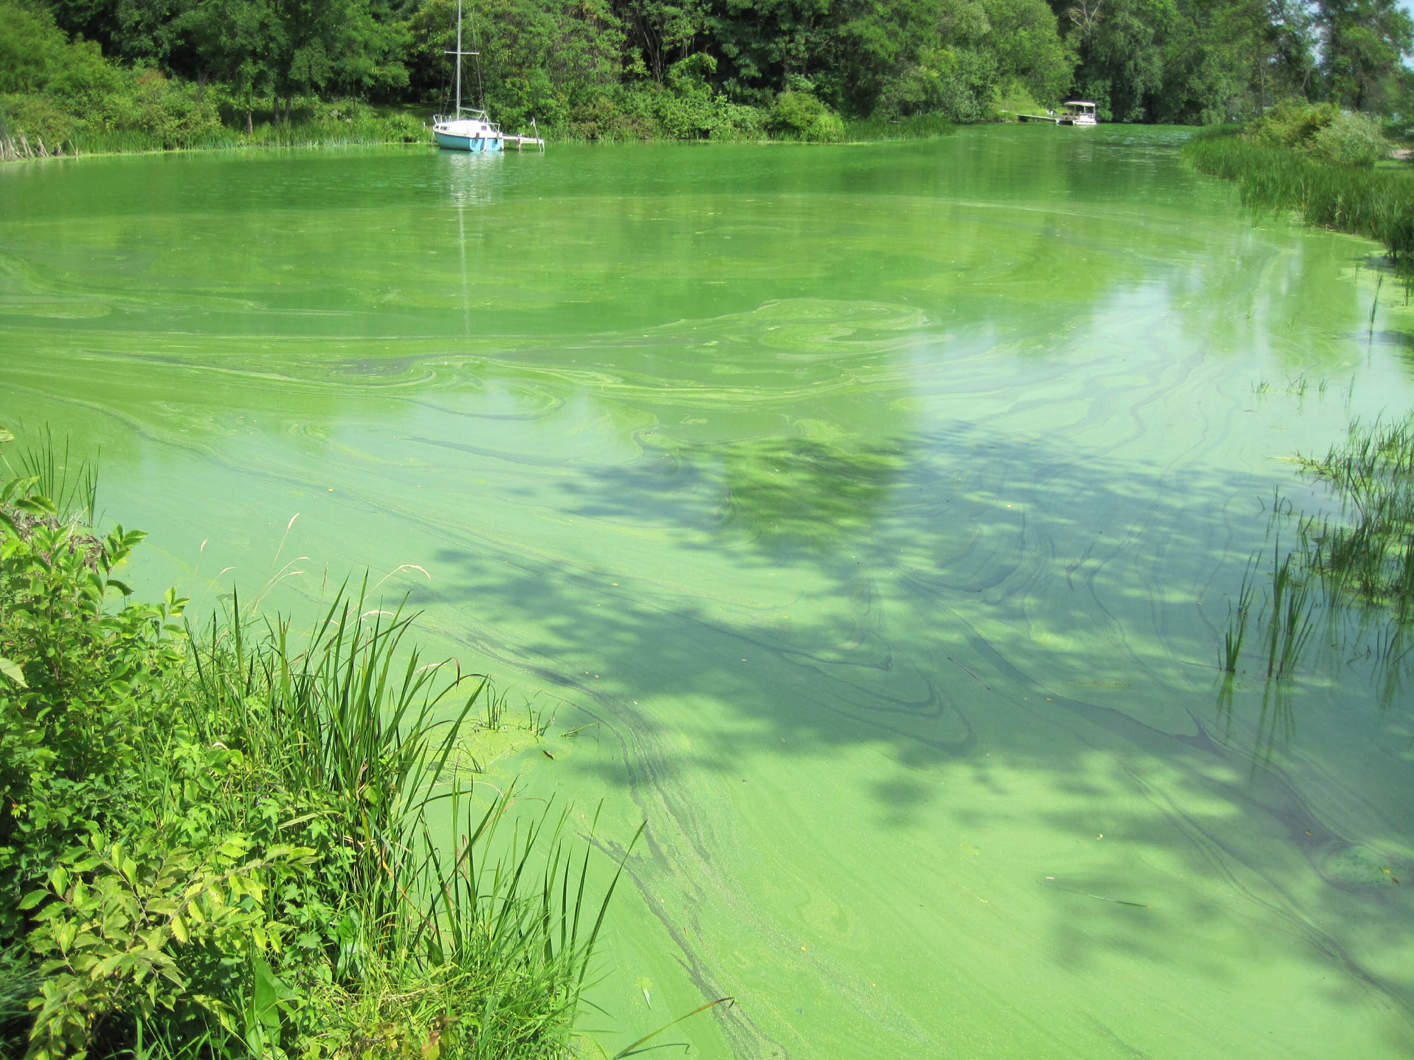
Nitrogen and Phosphorus
Primary sources of excess N and P include agricultural and residential use of fertilizers.
N and P concentrations can be measured in water with pertinent equipment, and their values compared to Indiana state standards to help determine lake health.

Slide 20
Project End-Products

Slide 21
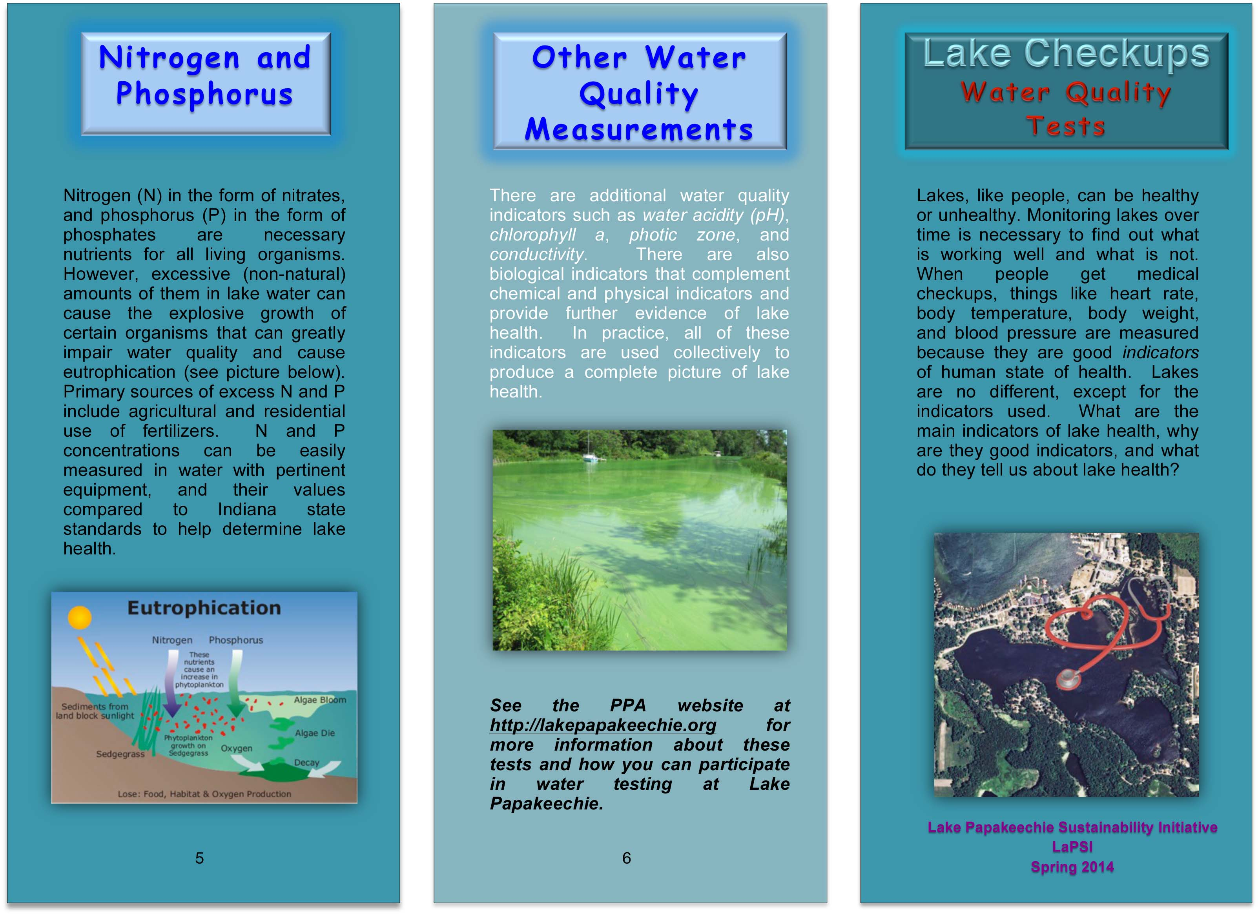
Tri-Fold Pamphlet – Side 1

Slide 22
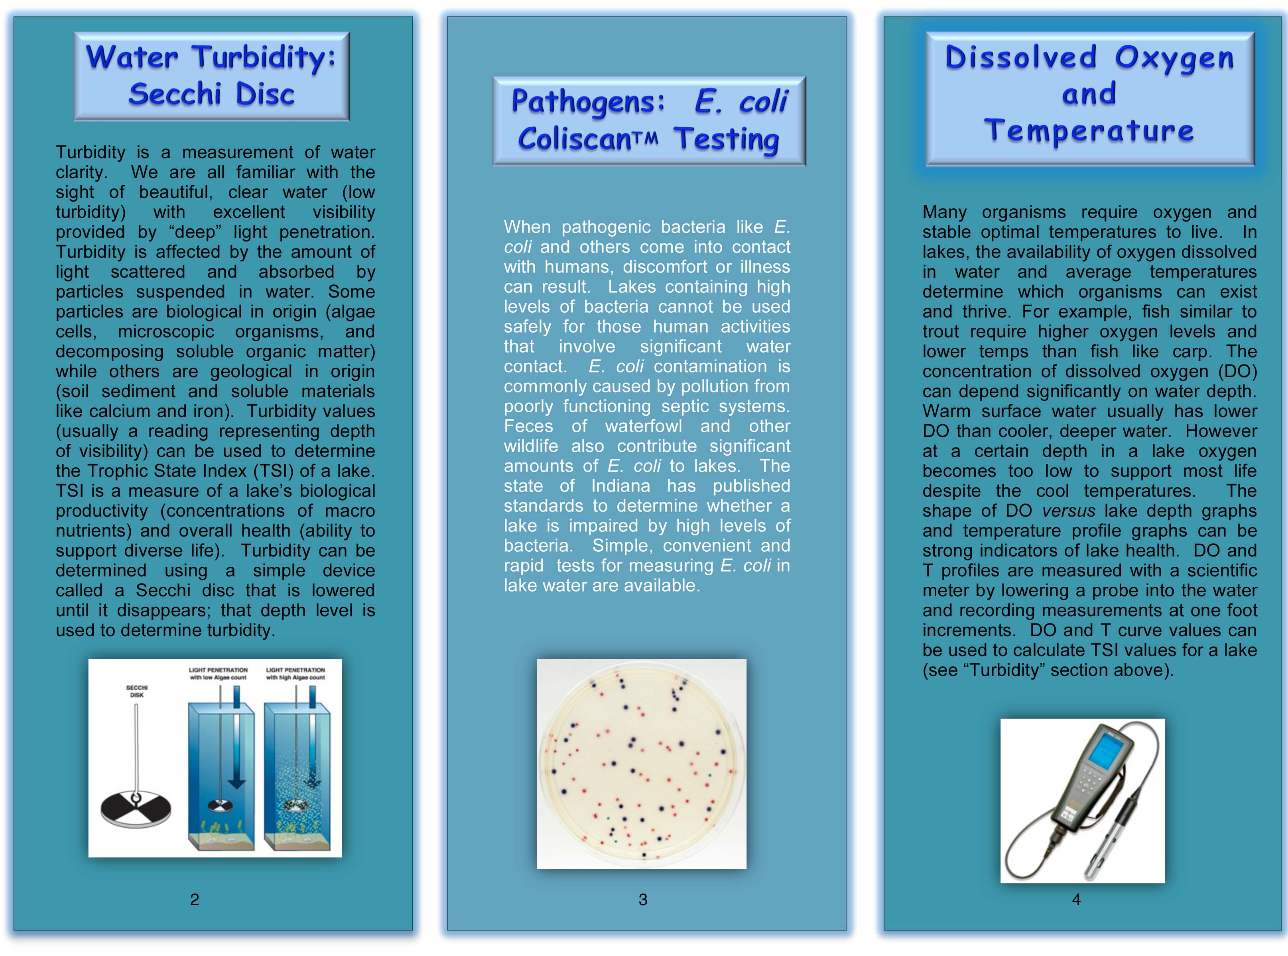
Tri-Fold Pamphlet – Side 2

Slide 23
Magnet

Slide 24
Summary
A tri-fold pamphlet was produced to introduce lake residents to common methods used to test lake water quality.
A magnet containing abbreviated information from the pamphlet was produced for convenient siting in residents’ homes.
Links to the PPA website were given in the pamphlet and magnet media to entice lake residents to use the web site more regularly as a source of information on current lake management projects and practices (work in progress).
The longer-term expectation is that these communication tools will educate lake residents and leadership about water quality and promote their active involvement in lake management.

